Slide 1
Presentation on
LEVERAGING CPFTA FOR NATIONAL ECONOMIC GROWTH AMIDST GLOBAL CRISES
@ Dr. Hassan Daud Butt ( CEO KP BOI/SEZA) & Miss Urooj Aijaz ( Bahria University)
30th June, 2022

Slide 2
Introduction
Free trade agreements (FTAs) have been at the forefront of the trade negotiators in recent years
Asia is a relative latecomer in the negotiation of FTAs, but the region has been catching up rapidly over the past decade
The number of preferential trade agreements (PTAs) and notified to the WTO have significantly increased between 1990 and 2015 (Hofmann et al., 2018)
As on Jan 2022, there were 47 FTAs in Asia, most of them bilateral, involving one or more countries from the region signed with Pakistan and similarly, China has signed 17 FTA with regional and extra regional countries
These FTAs gains significance in studying the economic potential between the two partner countries especially in the backdrop of the China Pak Economic Corridor (CPEC), the FTA covered goods, services and possible investment potential
Free trade, according to liberal trade theories enhances exports by increasing the efficient allocation of limited resources. Pakistan implemented various policy measures to raise exports and improve global economic integration, although exports (as a percentage of GDP) remained relatively unchanged (McCartney, 2020)
FTAs, on the other side, are a potent weapon that can drastically alter a country's bilateral trade and economic standing. In the argument over the efficacy of FTAs, the conflicting forces of trade creation and trade diversion create a contradiction. FTAs are said to improve trade and encourage governments to pursue free multilateral trade agreements
Following 9/11, China-Pakistan economic and trade relations strengthened and have lasted throughout the South Asian region's economic ups and downs. The structure of the two countries' agreement on trade is constantly a source of new commercial possibilities, such as lowering tariffs, revising quotas on import and export, and eradicating obstacles. Such agreements entice investors to help a country's economy (Hussain & Rao, 2020)

Slide 3
Introduction
Pakistan's reliance on China for commerce has grown in recent years, on both sides, China's reliance on Pakistan is low. Exports to China made up 7.7% of overall exports in 2016, while imports from China made up 29% of total imports. (S. H. Shah et al., 2020)
The Phase I of the China Pakistan Free Trade Agreement (CPFTA) came into operation in 2007 and was widely criticized for failing to provide preferential access for Pakistani exports into the large Chinese markets
Accordingly, Phase II of the CPFTA, which was signed in early 2019 and entered its implementation phase from January 1, 2020
Historically, the China-Pakistan relationship was more political and strategic. However, the changing character of international relations, as well as the growing need for economic cooperation, forced China and Pakistan to collaborate on economic matters. (Firdous et al., 2021)
Growth in exports to China including drivers of blue growth i-e Sea foods, mechanical goods and organic chemicals but on the whole leading competitiveness of China was quite prominent during the whole phase where misreporting of trade data leave footprints on mutual trade

Slide 4
Significance of the Study
Through this study, officials, academicians and researchers will learn about the importance of the trade agreements with regional countries and identify bottlenecks to accrue desired results from the FTAs. Also, the practitioners and policymakers may ensure that how there will be a smooth trade between Pakistan and China
The findings of the study will be used by a variety of stakeholders interested to work in the domain of the future of Pakistan’s trade with China as this study compares the imports and exports of Pakistan to China during and after the CPFTA 1st phase based on the annual GDP growth rate of Pakistan. The data on imports and exports were taken from World Integrated Trade Solution (WITS, 2022) database while the data on GDP annual growth has been taken from World Development Indicators (WDI, 2022) database
Overall, solutions to achieve desired outcomes through the CPFTA will be explored for sustainable long-term economic growth and bilateral trade and facilitate the trade that can address challenges to livelihoods, poverty alleviation, provision of global public goods employment creation, and the global order
This study also works on Blue growth, Agri Sector opportunities under CPEC and Pakistan’s trade by adding literature on these domains

Slide 5
Research Objective
The literature on distributional aspects of free trade agreements is still limited
This study is aimed at identifying bottlenecks to achieve objects and make recommendations that would allow policy makers to better evaluate the costs and benefits of the FTA
Secondly, it can help prepare measures to address the negative impact of the agreements and focus on the parts of the agreement yielding the highest returns
Lastly, the objective of the study is to learn more about how the China-Pakistan (CPFTA) affects Pakistan's trade system and how CPFTA can be leveraged for economic growth amidst global economic crises

Slide 6
Literature Review: China-Pakistan Free Trade Agreement (CPFTA)
The FTA encourages member nations to increase production, trade, and investment, resulting in increased growth in the economy. Trade flows between nations that are based on trade agreements may be classified into two categories: inter-industry trade (IT) and intra-industry trade (IIT) . IT is the inter-economy trading of completely diverse goods
Countries frequently invest in IT to improve their competitiveness (Zahid et al., 2021) The China-Pakistan CPFTA was signed on November 24, 2006, and it went into impact in July 2007 (Mukhtar, 2018) The CPFTA addressed expropriation, investment, and its treatment, promotion and protection, dispute settlement, and restitution for damages or losses (S. H. Shah et al., 2020) According to the CPFTA, Pakistan and China will begin removing or reducing tariffs on all goods in two phases (Abdul Kamal et al., 2021) The first phase of tariff reductions began in 2006, and the phase 2 began two years later It was also decided that during Phase I of the CPFTA, both countries will lower tariffs by 85% within five years of implementation (Qayyum & Nigar, 2020)

Slide 7
Literature Review: China-Pakistan Free Trade Agreement (CPFTA)
Preliminary Analysis of Pak China FTA Phase II
2005
Before Trade Agreement
2005: Bilateral Trade
USD 4.26 bn; Pak Exports to China USD 833.2 mn
2007-2012
Phase-I of CPFTA
Pakistan gained concessions on 6,418 tariff lines
2007: Bilateral Trade
USD 7 bn; Pak Exports to China USD 1.1 bn
2012: Bilateral Trade
USD 12.4 bn; Pak Exports to China USD 3.14 bn
April 2019
Protocol on Phase-II of CPFTA signed
Under Phase-II
China will liberalize 75% tariff lines
Bilateral Trade
July 18 – Mar 19
USD 7.4 bn; Pak Exports to China USD 1.48
2006
Early Harvest Program
Pakistan gained 644 zero-tariff lines at 8-digit level
Bilateral Trade
USD 5.25 bn; Pak Exports to China USD 1.0 bn
2012-2019
Negotiations on Phase-II
2018: Bilateral Trade
USD 19.1 bn; Pak Exports to China USD 1.1 bn
2012: Bilateral Trade
USD 2.2 bn

Slide 8
Literature Review: Negotiation for CPFTA
Interaction with the experts and the literature suggests that the negotiation of FTA with China did in any way was not influence by the existing strategic relationship between the two countries, Neither was influenced by any regional activity (ADB report of FTA in Asia,2008)
At the time there was no discussion on regional trading blocs as is emerging today in case of the Ukraine crisis and the US-China trade war The obvious focus was that Pakistan can obtain preferred access to the markets of China and was the subject of considerable debate, particularly as to whether it would threaten local industry The challenge during negotiation also came with different rules negotiated under different agreements, enforcement of these rules and compliance with them by local businesses, failure to understand business culture including the different dispute settlement mechanisms as well as different standards regimes and other harmonization arrangements In recent years, Pakistan and China invested heavily in upgrading their domestic and cross border infrastructure, bringing down trade costs, also, small and medium-sized enterprises (SMEs) were to be connected to connect to international markets and reap the benefits of improved connectivity, overall, better connectivity and the integration of SMEs was anticipated to further boost trade and increase growth. The other benefits that were aimed at are: a. Increases access to higher quality, lower-priced goods. b. Ease inflationary pressure c. Reduction in the businesses’ production costs and promotion of economic growth. d. Promote efficiency and innovation

Slide 9
Literature Review: The Benefits and Issues
The increase in imports from China is primarily due to:
The surge in machinery and equipment in the context of Pakistan's development activities Import diversion from other trading partners to China The increase in demand for imported raw materials due to the emergence of local assembly businesses. The robust demand for low-cost goods; and Trade diversion from informal to formal channels following the signing of the CPFTA (S. H. Shah et al., 2020). Imports of low-cost machinery assist Pakistan in upgrading its domestic industries. The majority of Pakistan's imports from China were capital goods, which might help the country's economy in two ways: Chinese machinery, particularly in the textile and cement sectors, may assist local industry in upgrading its technology (Jahangir et al., 2020) Imported machinery may be used in public sector projects in the electricity and infrastructure sectors (including those related to CPEC efforts). These imports can assist alleviate energy supply limitations while also supporting ongoing infrastructure development efforts in the country (McCartney, 2020)

Slide 10
Literature Review: Drawbacks of CPFTA for Pakistan
Despite the fact that the two nations signed an FTA in 2006, Pakistan remains a little contributor to China's overall commerce (S. H. Shah et al., 2020)
Despite the fact that China's global imports have surpassed $1 trillion, Pakistan plays a minor role.(Haq et al., 2021) Pakistan's exports to China were barely US$1.82 billion in the 2018 fiscal year (UN, 2018), while China's exports to Pakistan increased from $3.5 billion to $18.25 billion between 2006 and 2017. (Jenkins, 2018) Pakistan's and China's trade balances have also been skewed, e.g., Pakistan's exports to China grew from US$0.4 billion in 2005 to US$1.82 billion in 2018, while imports from China increased from US$1.8 billion in 2005 to US$18.2 billion in 2017 (Haq et al., 2021) Furthermore, due to their low cost, Chinese items have become extremely popular in Pakistan (Akhtar, 2019). Pakistani goods, on the other hand, are not sold at a premium when they are exported to China Similarly, Pakistan has only used about 5% of the available CPFTA concessions, but China has used more than 55% of the available CPFTA concessions. (Mukhtar, 2018) Similarly, Openness to international flow of goods and services can increase national income, which in turn enables moving forward on resource intensive development However, in case of CPFTA the same count not be achieved and thus, the benefits of FTA related trade opening are being increasingly called into question, it is therefore crucial to fully understand how trade interacts with the various goals as Trade integration holds many opportunities for development, but at the same time, can have risks that need to be managed.

Slide 11
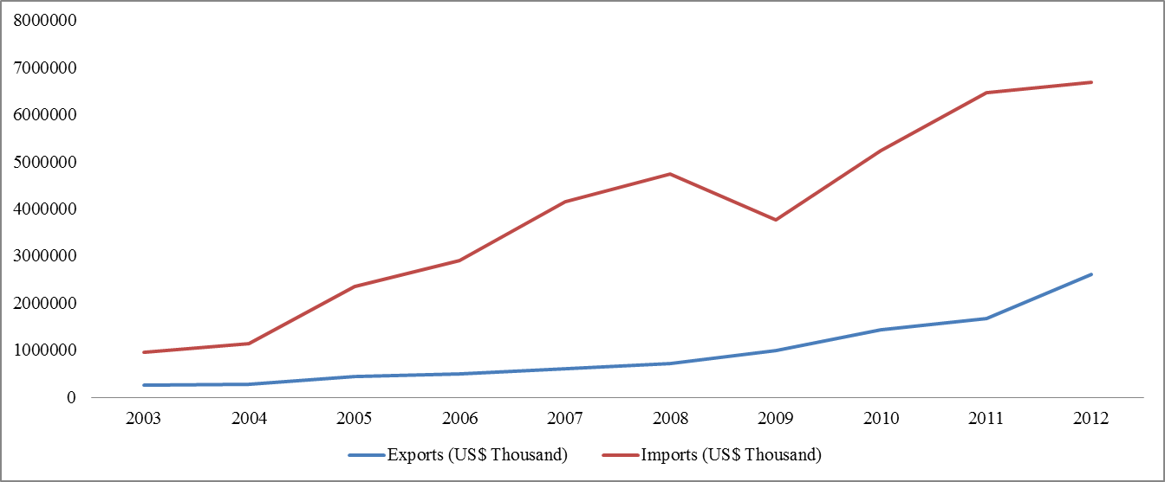
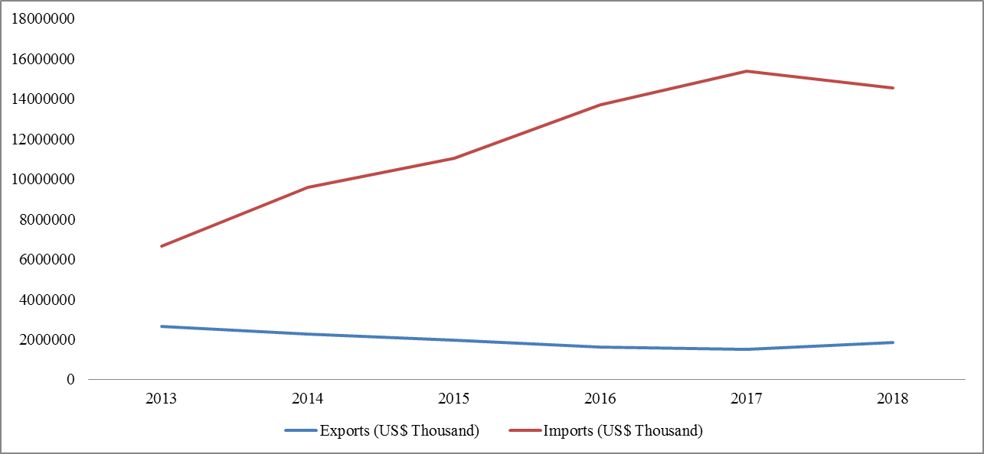
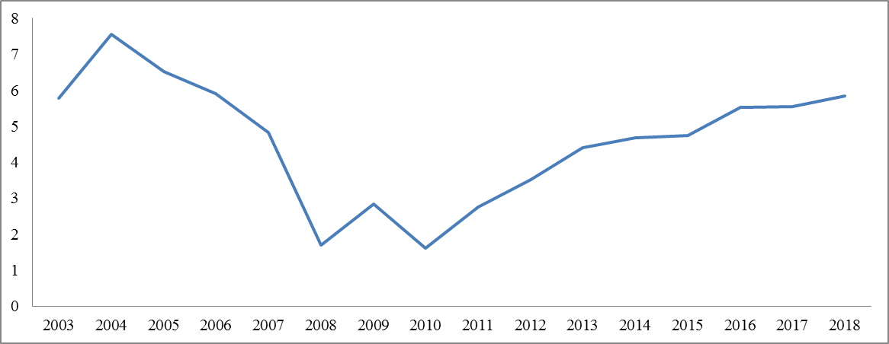
Literature Review: CPFTA and Pakistan’s Trade
Figure 1: Import and Export in US$ Thousands (CPFTA Tenure)
Source: Authors’ Estimation
Figure 2: Import and Export in US$ Thousands (Non CPFTA Tenure)
Source: Authors’ Estimation
Figure 3: Economic Growth (Annual %)
Source: Authors’ Estimation
During the 1st phase of CPFTA, as shown in figure 1, Pakistan’s exports to China have been increased slightly in the last years while Pakistan’s imports from China have little fluctuation but were in large volumes
Figure 2 showed that in the non-CPFTA tenure, Pakistan’s import from China has been increased drastically while the exports were stable at the lowest benchmarks. During 2013 to 2017, there was a gradual but steady increment in imports from China (I. H. Shah et al., 2020)
As shown in figure 3, Pakistan’s economy has continuously faced decline during the 1st phase of CPFTA; however, just in the last year of the 1st phase of CPFTA, Pakistan’s economic growth has again revitalizing its annual economic growth of more than 5%.

Slide 12
Literature Review: Impediments in Expanding Exports to China
It is observed that Pakistan’s trade deficit with China gradually forms upward trajectory where we allow 6711 Chinese goods to enter in our market on concessional rates under first phase of CPFTA where goods are categorized in:
USD Billion | 2013 | 2014 | 2015 | 2016 | 2017
Imports China | 6.63 | 9.59 | 11.02 | 13.68 | 15.40
Exports to China | 2.65 | 2.25 | 1.93 | 1.59 | 1.51
Pakistan’s Trade Deficit with China | 3.97 | 7.34 | 9.08 | 12.09 | 13.89
Category 1: Elimination of tariff for three years
Category 2: 0-5% for five years
Category 3: Reduction of Margin of Preference to 50% for five years
Category 4: Reduction on Margin of Preference up to 20% for five years
Category 5: No concession
Category 6: Exclusion
Source: Pakistan’s trade with China (USD Billions) (2013-17)
 | Pakistan’s Exports to China (2017) Value (USD Mn) |  | Pakistan’s Exports to China (2016) Value (USD Mn) |  | Pakistan’s Exports to China (2015) Value (USD Mn)
Category 1 – zero tariff (2,681 tariff lines – 35.5%) | 438 | 29% | 346 | 22% | 510 | 26%
Category 2 – 0.-5% (2,604 tariff lines – 34.5%) | 825 | 55% | 869 | 55% | 1,087 | 56%
Category 3–50% Reduction (604 tariff lines – 8%) | 17 | 1% | 16 | 1% | 13 | 1%
Category 4–20% Reduction (529 tariff lines – 7%) | 24 | 2% | 23 | 1% | 18 | 1%
Category 5– No Connection (1,132 tariff lines – 15%) | 199 | 13% | 326 | 20% | 277 | 14%
 | 1,508 |  | 1,591 |  | 1,935
Similarly, China allowed 7550 goods from Pakistan to enter in their market under the categories of,
Category 1: Elimination of tariff for three years
Category 2: Tariff reduced to 0-5% for five years
Category 3: 50% reduction in tariff rates for five years
Category 4: 20% reduction in tariff rates for five years
Category 5: No concession
Source: Break-up of Pakistan’s exports to China by categories defined under the CPFTA (USD Millions) (2015-17)

Slide 13
Literature Review: China-Pakistan Economic Corridor (CPEC) and CPFTA
The CPFTA is an FTA between China and Pakistan that aims to boost trade and develop bilateral ties between the two countries. Previous agreements in the economic and commercial cooperation include the Preferential Commercial Agreement (PTA) in 2003, the Early Harvest Program (EHP) in 2006, and the CPEC in 2015 (S. H. Shah et al., 2020)
The 1st phase of the CPFTA ended in Dec 2012, while the 2nd phase was signed in April 2019 and took effect on Jan 1, 2020, in 2024, the current phase should be completed, the CPFTA’s 2nd phase intends to settle these difficulties, enhance the trading relationship between the two countries, and liberalize trade even more, China and Pakistan intend to raise bilateral trade to $15–20 billion by the conclusion of the third phase and eliminate tariffs on 75% of product lines. (Khan et al., 2019) During negotiations Fresh principles were agreed by both the sides to address the concerns raised in result of CPFTA 2006 (Hamid Mukhtar, 2019) CPFTA improves both nations' market access. China has dropped tariffs on 44 percent more product categories in the second phase than it did in the first (Zahid et al., 2021) China promptly removed duties on 313 product categories from Pakistan, notably frozen meat, textiles and other animal products, ready-to-eat meals, plastics, footwear, chemicals, items, leather, seafood, oilseeds, engineering items and auto components are all examples. Pakistan has given China quick access to its market for machinery, intermediate goods, and raw resources. (Aslam, 2020)

Slide 14
Literature Review: China-Pakistan Economic Corridor (CPEC) and CPFTA
The CPFTA's first phase featured safeguard mechanisms, but the second phase revised them to make them more accessible so that local firms in both nations could be protected. (Abdul Kamal et al., 2021) It has gained broad support from business organizations and domestic industry in Pakistan, as it includes safeguard procedures to protect local industry in both China and Pakistan. Phase two has also been praised by Pakistani business associations as a substantial improvement in Pakistan's commercial access to China. (Zahid et al., 2021) Moreover, Pakistan has gained a competitive advantage over its primary export competitor, China, because it will be subject to reduced tariffs. Pakistan has a competitive advantage in 80 percent of product categories, such as machinery, mechanical appliances, plastics, steel, and iron. (S. H. Shah et al., 2020)

Slide 15
Methodology
The study has compared the imports and exports of Pakistan to China during and after the CPFTA 1st phase based on the annual GDP growth rate of Pakistan
The data of imports and exports were taken from World Integrated Trade Solution (WITS, 2022) database while the data of GDP annual growth has been taken from World Development Indicators (WDI, 2022) database
The study has taken two time periods separately for analyses (1) 2003 to 2012; CPFTA tenure/period and (2) 2013 to 2018 non-CPFTA tenure/period. For the graphical representation, and statistical analysis purposes, Microsoft Excel 2013 and EViews 9 have been used respectively

Slide 16
Results and Discussions
Based on the statistical inferential results of regression analysis, the following results have been estimated
Above table clearly showed that Pakistan’s exports and imports to China did not affect Pakistan’s economic growth during the CPFTA 1st phase tenure (between 2003 and 2012); however, Pakistan’s exports to China has negatively affected the Pakistan’s economic growth in the non-CPFTA tenure
In a nutshell, it has been manifested from the data that CPFTA have not been proven effective for trade-growth relationship of Pakistan. Furthermore, Pakistan’s imports from China have also not supported Pakistan’s economy in anyway
Table
Regression Analysis (Economic Growth; Annual %)
Variable | CPFTA (2003 - 2012) |  |  | Non-CPFTA (2013 - 2018)
 | Beta | S. E. | Prob. | Beta | S. E. | Prob.
Constant | 7.863 | 15.819 | 0.640 | 102.090 | 18.012 | 0.111
Log (Exports to China) | -1.557 | 3.181 | 0.645 | -13.297 | 1.804 | 0.086
Log (Imports to China) | -5.543 | 5.595 | 0.367 | -0.454 | 0.824 | 0.680
Consumer Price Index | 0.011 | 0.208 | 0.959 | 0.005 | 0.021 | 0.837
Exchange Rate | 0.414 | 0.292 | 0.216 | -0.091 | 0.011 | 0.075
R-Square | 0.848 |  |  | 0.999
Adjusted R-Square | 0.726 |  |  | 0.993
F-Statistics (Prob.) | 6.960 (0.028) |  |  | 168.906 (0.058)

Slide 17
Results and Discussions
Lessons for Pakistan from CPFTA Phase-I
Most of Pakistani exporters experience supply side issues in Pakistan and information gaps in all domains at China where this issue becomes serious concern when the companies are unable to target markets in China as they are quite familiar with European and USA markets but totally unaware at Chinese competitive market due to language barriers which require specific efforts at state level and through commercial councilors
Although the first phase is gone but the lessons we learn from first phase require to be targeted in the second to make Pakistan beneficiary of CPFTA where diversified exports should the point of attention for Pakistan According to research of Pakistan Business Council China utilize 55.87% of total goods offered for concession in CPFTA-I out of which almost 50% goods are 0 rated while Pakistan only utilize 5% of 0 rated goods showing loop holes in our negotiations which must be considered in future before signing any FTA
In addition, permitting huge variety of imports from China (even at the low cost) at the stake of domestic industries is the real challenge for local investors. Many complaints are at the record of National Tariff Commission regarding the dumping activities of Chinese goods where they impose anti-dumping restrictions for regulation but the policies seems ineffective and results alarming situation in case of trade imbalances where pace of increase in Chinese exports is very high as compared to Pakistan, but these Chinese exports (imports for Pakistan) is necessary for Pakistan as due to low cost after concessions Pakistan’s Industries are gaining profits

Slide 18
Conclusion & Recommendations
The FTA trade agreements with China and other partners are crafted with a short, medium and long-term objectives
These targets set by the governments for economic integration needs to focused towards enhancement of trade, improvement of efficiency and connectivity of trade logistics infrastructure, eliminating NTBs and harmonizing regulatory measures, and promoting the integration of member States to regional and global value chains
The results suggest that of the FTA has the potential ingredients that can yield the largest macro-economic gains for Pakistan in terms of income, output and exports. We examined the strength of trade relations between the two strategic partners
The results show that Pakistan’s trading relations with China has strengthened and intensified since the signing of the FTA, Trade reciprocity between Pakistan with China, indicate positive effects from the integration
However, the trade reciprocity also indicates that bilateral trade is not yet balanced, suggesting room for further improvement. Intra-industry trade has developed in selected industries, with huge scope for investment through CPEC especially agriculture and food products, construction material
As a result, along with the rapid increase of intra-industry trade, new tradable industries arose, which made inter-industry trade, grow even faster than previously, one concern expressed during the FTA negotiations was that the larger partner would dominate the smaller one

Slide 19
Conclusion & Recommendations
For exporters of citrus and seafood, the main impediments on the demand-side are lack of consumer awareness and technical barriers to trade (TBT) sanitary and phytosanitary (SPS) requirements compared to other export markets
There is also a lack of mutual recognition of standards and certificates, and a testing process in China that is considered unnecessarily time-consuming and complex, this can be addressed through Fast implementation of the Strategic agreement On Agriculture and livestock in CPEC Framework and setting up FMD Free zones in Punjab, KP and in Sindh, the Pakistan government should work with China to create testing facilities at the land border with China
FTA's economic and political interests should be aligned with the CPEC's goals and priorities, according to Islamabad, to ensure that all provinces gain equitably, build political consensus on the project's path, especially through debates in national and provincial legislatures, and end arrests, intimidation, and other types of opposition pressure
The results of the study highlights that the objectives and plan for implementation of FTAs along with the road map was well designed for accruing benefits from a neighbor which has the market that can benefit Pakistan
CPEC and Gwadar, on the other hand, provide new trading opportunities. With Pakistan, China, Central Asia, Russia, and other nations, more regional integration appears to be taking place as a result of the BRI and CPEC

Slide 20
Conclusion & Recommendations
Similarly, to cope with competing goods, Value-added and modernized Pakistani exports are necessary. Additionally, stronger people-to-people and business-to-business links that enhance our overall bilateral relationships with China. Following model is recommended:

Slide 22
1
THANK YOU

